Slide 1


Magic fight
IRS Project Video
Group 21
ZHANG XINGYU PENG SHAOZE TIAN YUYANG XU XINDI

Slide 2


Project Objectives
Traditional games: Single interaction and low immersion
Objective: All-round interactive gaming experience
Immersive Experience
Voice Control
Gesture Recognition
Virtual Reality

Slide 3
Tools and Techniques
Voice + Gesture data collection and preprocessing
Flask, Javascript, Google cloud storage bucket
Speech recognition, Gesture recognition model training
Tensorflow lite, Python
Embedded machine learning sensing system development
C++, Arduino Nano 33 BLE Sense
Bluetooth data transmission development
C#, Unity, Arduino Bluetooth Plugin
Unity game development
C#, Unity, UI

Slide 4
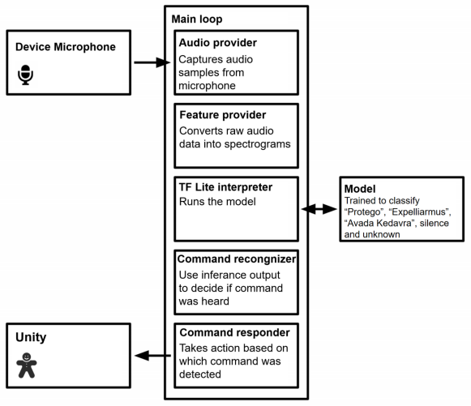
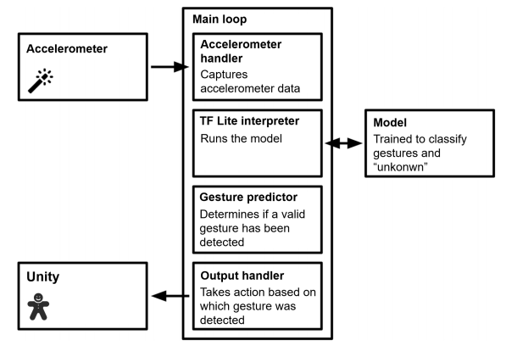
System Architecture
Speech Recognition
Action Recognition

Slide 5
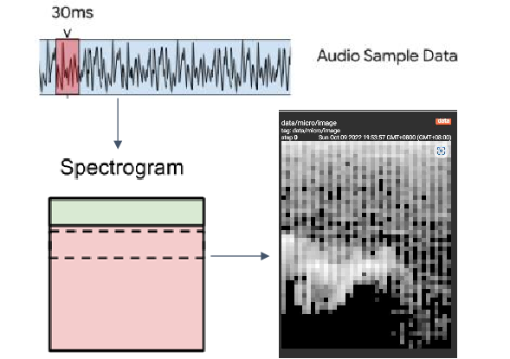
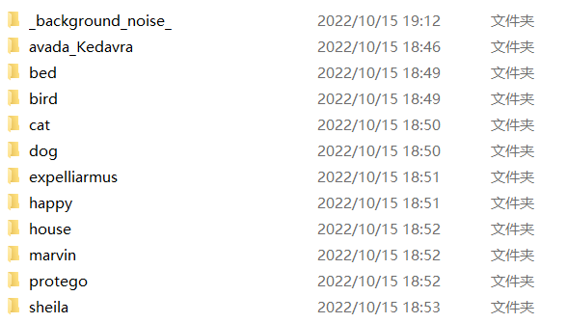
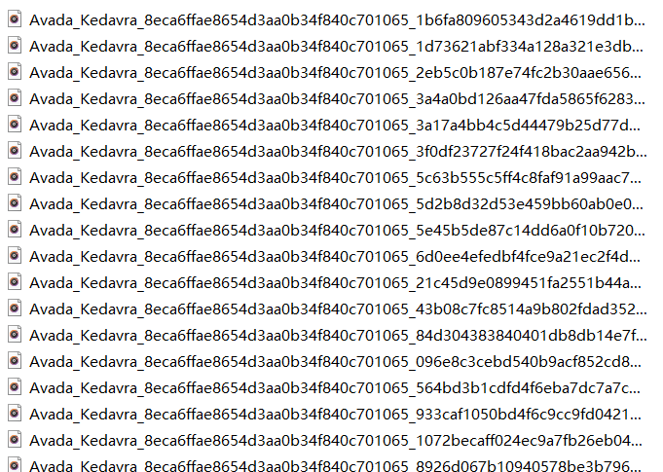
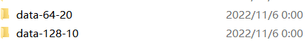
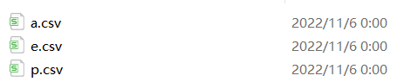
Speech Recognition Model
Data preprocessing
CNN model
Make data by our own voice collection website (https://magicfight.de.r.appspot.com)
MLP Model

Slide 6
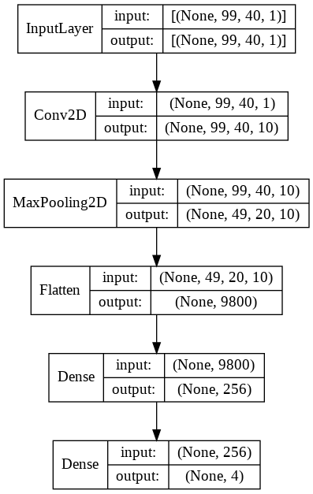
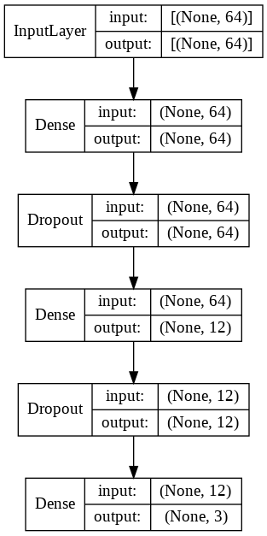
Speech Recognition Model
Model structure
CNN model
MLP Model

Slide 7
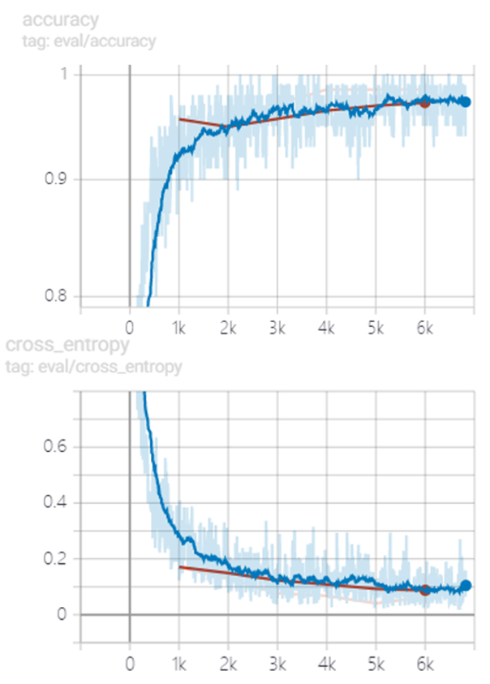
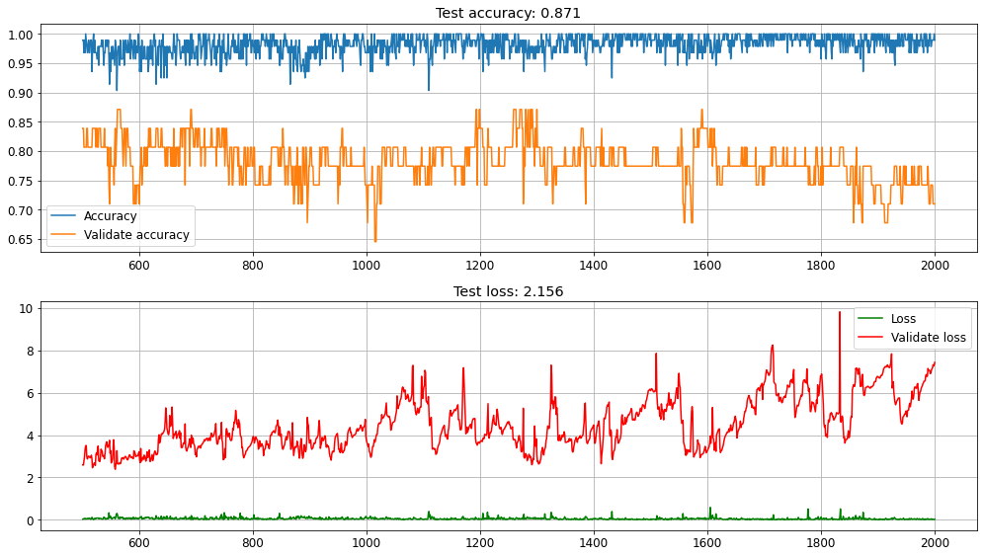
Speech Recognition Model
Model performance
CNN model
MLP Model

Slide 8
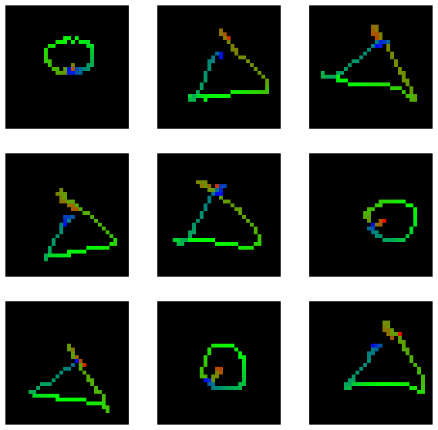
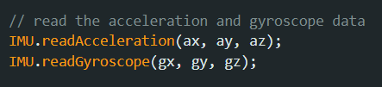
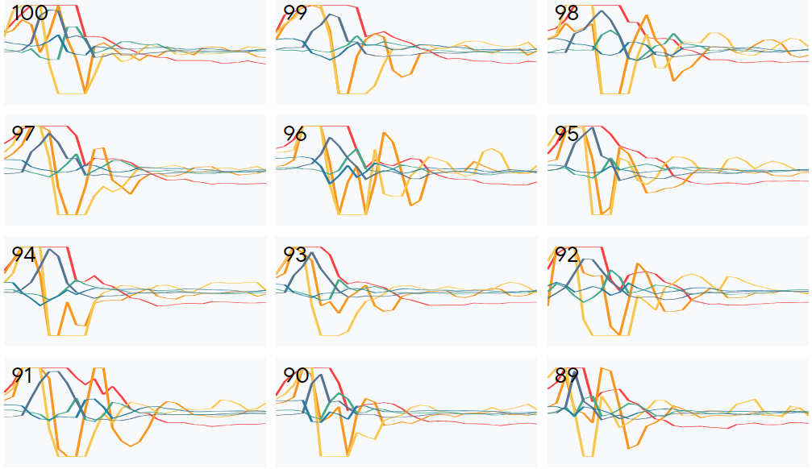
Gesture Recognition Model
Data preprocessing
CNN model
MLP Model

Slide 9
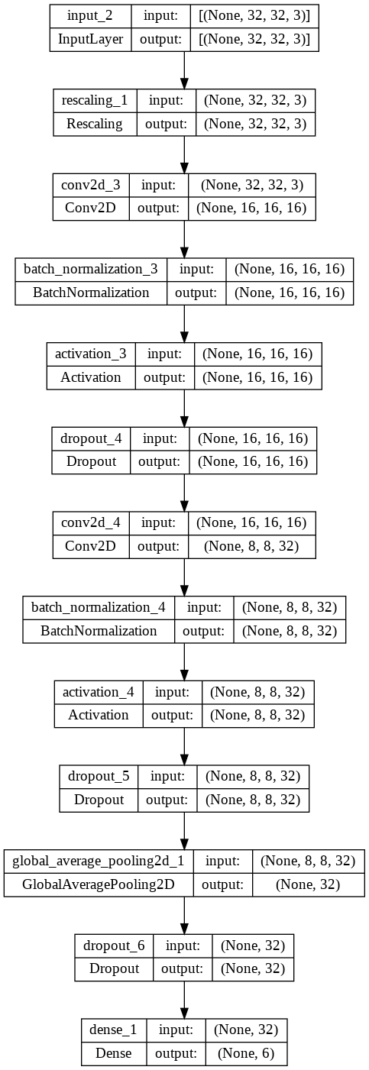
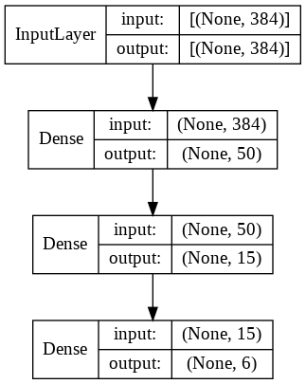
Gesture Recognition Model
Model structure
CNN model
MLP Model

Slide 10
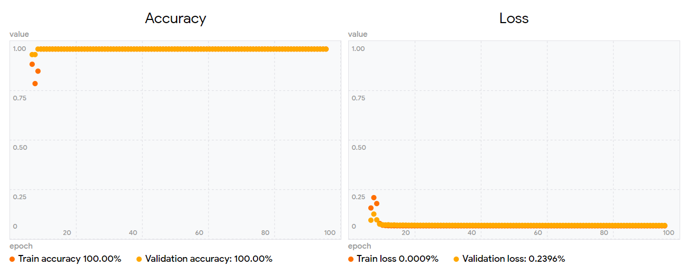
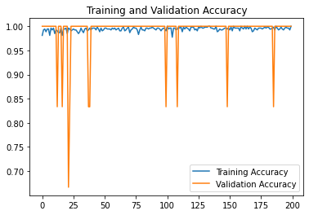
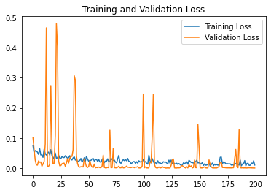
Gesture Recognition Model
Model performance
MLP Model
CNN model

Slide 11
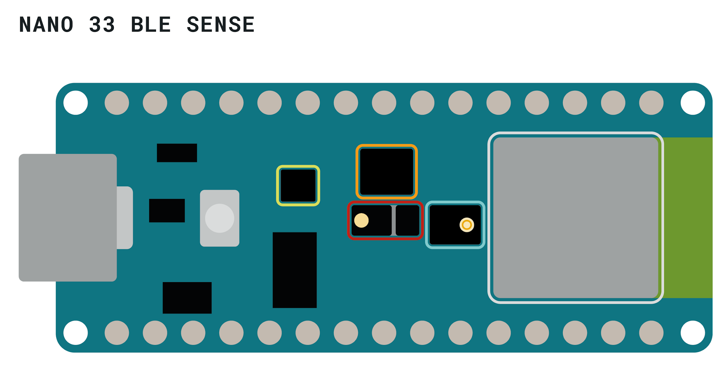
Board Embedded Development
Microphone
① Record audio samples → dataset making
② Capture audio → speech recognition
↓
Expelliarmus Avada Kedavra Protego
Gesture motion sensors and coordinate sensors
Bluetooth module
X, Y, Z axes → track → action recognition
↓
Connect to Unity
↓
transmit commands
Forward → cast magic
Laterally → block attack

Slide 12
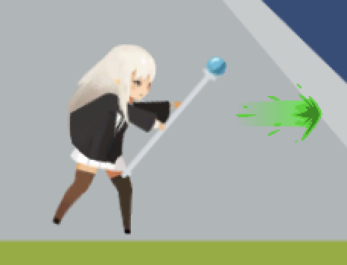


Unity Game Development
speed: slow
damage: huge
need to charge
fatal,could not be blocked by Protego and lateral gesture
Avada Kedavra
could only block
one damage at a time
speed: fast
damage: common
could be blocked by lateral gesture and Protego
Protego
Expelliarmus

Slide 13
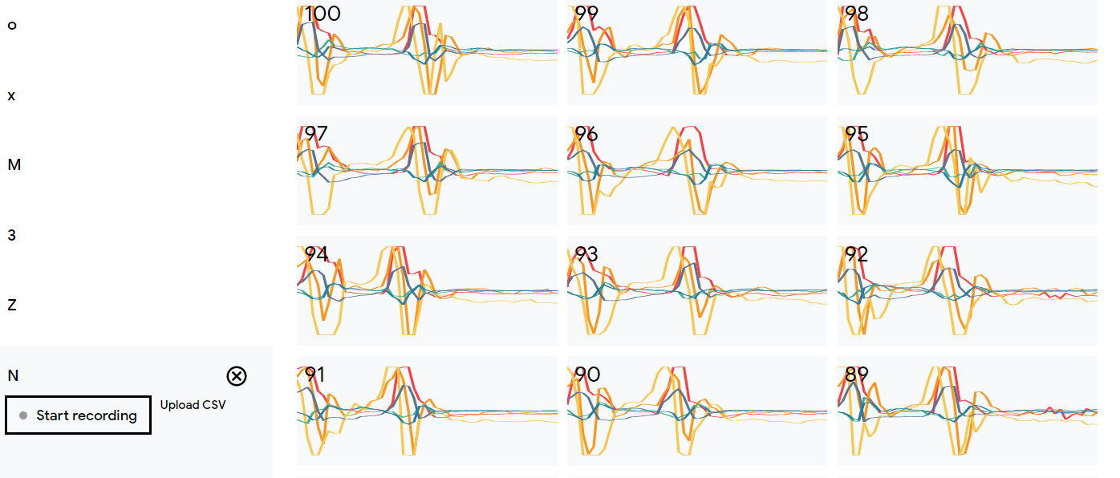
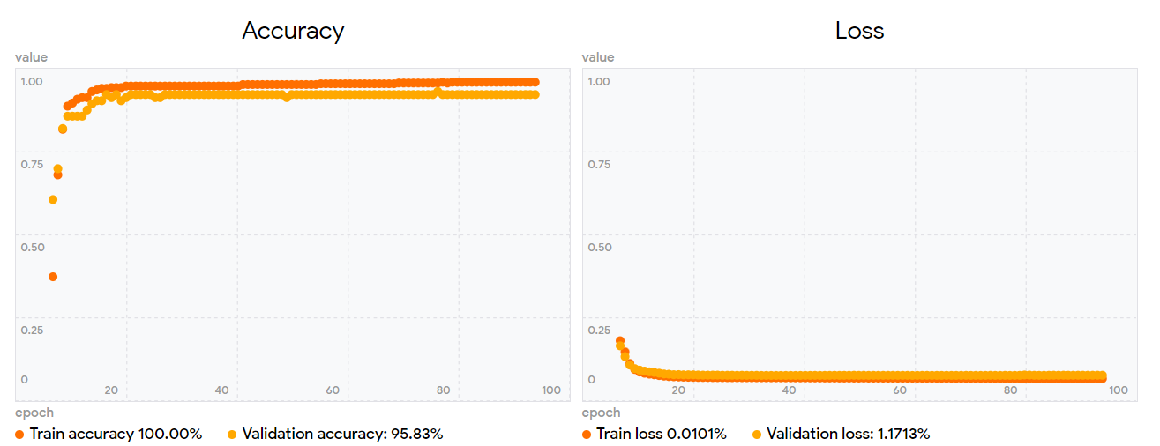
Future Improvement
At present, we have carried out the next step of design: adding silent spell
We have completed the model training of six silent mantras, and the test set also shows good results

Slide 14
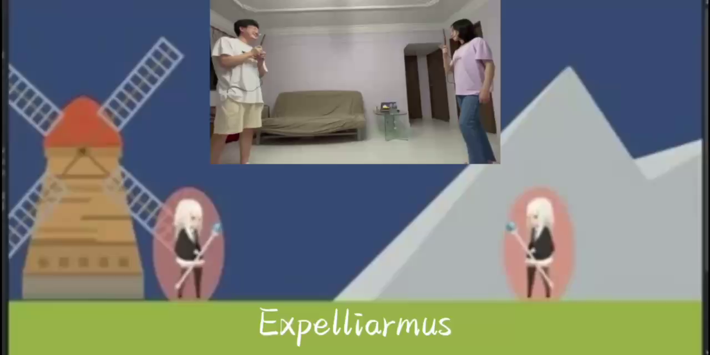
Display

Slide 15
Thank you !
Refer to project details on our Github repo
https://github.com/zxypro1/MagicFight

